Slide 1


NUS ISY5002 Team Eagle Final Presentation
Sep 26, 2022
Nair Prashant Chathuar Balachandran A0249268N
Nakahara Hirotoshi, A0232336M
Pradeep Janakiraman, A0140188H
Vikram Sankireddypally A0249306A

Slide 2
Executive summary
Background
What we did in the project
Video analytics is important because of following reasons:
Improvement of internet access across the globe
Penetration of social media such as Facebook, Instagram, YouTube and TikTok
Growth of the online advertising industry. The size is $556 bn in 2021 and expected to grow to $616 bn in 2022
Measurement of quality of videos is a crucial theme for the monetisation
More consumer watch duration, creators or advertisers can expect more benefit from the video exposures
However, the existing products may not be enough because of:
Only using metadata (example)
No implication about video contents in terms of creative things creators can control
We designed and demonstrated a system to predict following metrics of YouTube videos:
View count
Like count
To do that, we utilised following tools and technologies:
youtube-dl API to download YouTube videos and the metadata
FF mpeg tool to cut the videos into sliced images
Based on the above input data, we developed a deep-learning model to predict the metrics
Input data (X): thumbnails, 18 sliced video images, metadata (height, width, fps, duration)
Output data (y): view count and like count
Structure: combination of different DL models such as LSTM, CNN
Limit the video categories within dog and cat for the simplicity
Volume of samples: 1,207 videos

Slide 3
The updated product design
Thumbnail images
youtube-dl (API to download metadata, videos)
18 sliced images per video
Feedback
Video cutting (FF mpeg)
Sliced video images
Deep learning model
Prediction (view counts, like counts)
URL list
(YouTube BB data set)
Model Training (batch)
1,207 videos
(average 18 secs)
Meta data (height, width, duration, fps etc.)
Model update
Metadata (height, width, duration, fps)
Input data
Video
Video cutting (FF mpeg)
18 sliced images
Front App
Deep learning model
View/like counts prediction
Thumbnail
Apply the trained model to provide prediction

Slide 4
Data (updated)
Data category
Description
Data source
How to get the data
Data volume
Thumbnail *1
Thumbnail image file of videos
YouTube
Download thumbnails/videos by using youtube-dl API based on the URL list of dog and cat category in YouTube BB dataset.
Videos are sliced by using FF mpeg package.
18 sliced images are randomly selected across sliced images.*2
1,207 images
Sliced video images
Sliced images of videos*3
YouTube
1,207 videos x 18 sliced images per video*2 (randomly selected)
Input X
Metadata
Metadata of videos
(width, height, duration and fps)
YouTube
metadata
Download by using youtube-dl API based on the URL list of dog and cat category in YouTube BB dataset
1,207 rows x 4 columns (width, height, duration, fps)
View counts
View count of videos
YouTube metadata
1,207 rows x 3 columns (video_id, view counts, like counts)
Output y
Like counts
Like count of videos
YouTube metadata

Slide 5
Final deep learning model overview
CNN
Thumbnail image (224, 224, 3)
Reason to utilise a two layer structure:
There is strong correlation between like and view count (r = 0.66). Accurate like count prediction may result in accurate view count prediction.
Augmentation
Conv2D
MaxPooling
TimeDistributed CNN and LSTM
Same structure with the left model
(parameters are retrained)
Conv2D
Sliced video images (18, 180, 240, 3)
CNN
Metadata
TImedistributed CNN and LSTM
MaxPooling
TimeDistributed layer (18 slices per video)
Predicted like count
Conv2D
MaxPooling
Augmentation
….
Augmentation
Conv2D
Metadata
Inception ResNet v2
….
Inception ResNet v2
Metadata (4)
Concatenate
MaxPooling
LSTM
Flatten
Conv2D
Dense
Dense
MaxPooling
Dense
Dropout
view count prediction
Dense
Dense
Dense
Concatenate
Flatten
Dense
like count prediction
Notes:
We created a two layer deep learning model to predict like count in the first layer and view count in the second layer. This is because there is strong correlation between like and view count. In the first layer, we assigned CNN, metadata and 18 sliced imaged videos per video. “18” is based on average video length in YouTube BB data source in cat and dog categories. Sliced images videos are processed TimeDistributed CNN layer with Inception ResNet v2 model then LSTM layer extracts features in the sequential process. All modules are concatenated to predict like count. In the second layer, predicted like count in the first layer is also utilised to training the model to predict view count.
Moreover, we also assigned data augmentation layer in thumbnail module and sliced video images module. The augmentation layer such as RandomFlip, Rotation, Translation, Zoom and Contrast contributed to reduce fluctuation of prediction. We understood data augmentation layer may ensure stability of the prediction to avoid situations that small perturbation on images has large prediction difference.

Slide 6
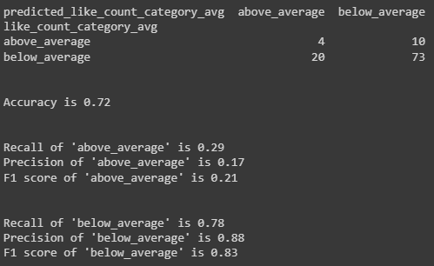
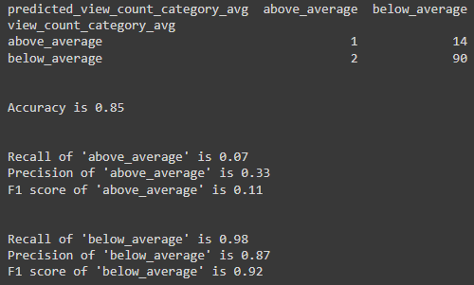
Final deep learning model result
Metrics
Performance with 107 samples in the test data*1
A model with loss function mean squared error (MSE) as a regression problem is trained.
Taking into account of the difficulty to predict like and view count exactly in the prediction model, the model is evaluated as a two category classification problem (below average or above average) after the regression model creation. The metrics are:
Accuracy
Recall
Precision
F1 score
Like count prediction
View count prediction
Overall accuracy is 72%
The model can detect videos have ‘below_average’ like count with 78% recall, 88% precision and 83% F1 score
The model can detect videos have ‘above_average’ like count with 29% recall, 17% precision and 21% F1 score
Overall accuracy is 85%
The model can detect videos have ‘below_average’ like count with 98% recall, 87% precision and 92% F1 score
The model can detect videos have ‘above_average’ like count with 7% recall, 33% precision and 11% F1 score
Notes:
In terms of model metrics, we trained the model based on MSE loss function. However, taking into account of the difficulty to predict like and view count of videos exactly, we evaluated the model as a two category classification problem which is “below average” or “above average”. Then accuracy, recall, precision and f1 score are calculated.
In the like count prediction, detection of “below_average” videos in the test data is better than “above_average” videos. Recall of “below_average” videos is 78% and precision is 88% while that of “above_average” were 17%, 21% respectively.
In the view count prediction, the result is not good compared to the like count prediction. While the overall accuracy is 85%, the prediction model is skewed to ‘below_average’. As the result, only one sample with “above_average” view count video out out of 15 samples can be detected.
In the real environment, we consider YouTube algorithm decides impression allocation to users. Probably YouTube recommends videos have high like count rate to broad users and the videos may get more view counts and like counts. There should be a cyclic system to increase view and like counts. It is impossible for you to utilise the YouTube internal data. However, the result implies that predicting relatively low performance in terms of like count may be possible even with publicly available data such as thumbnails, metadata and sliced images.

Slide 7
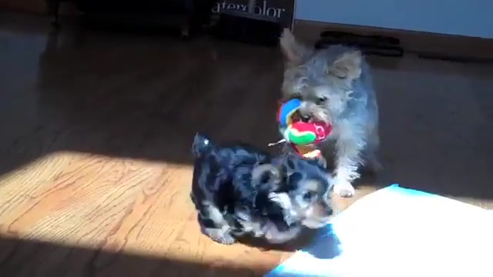
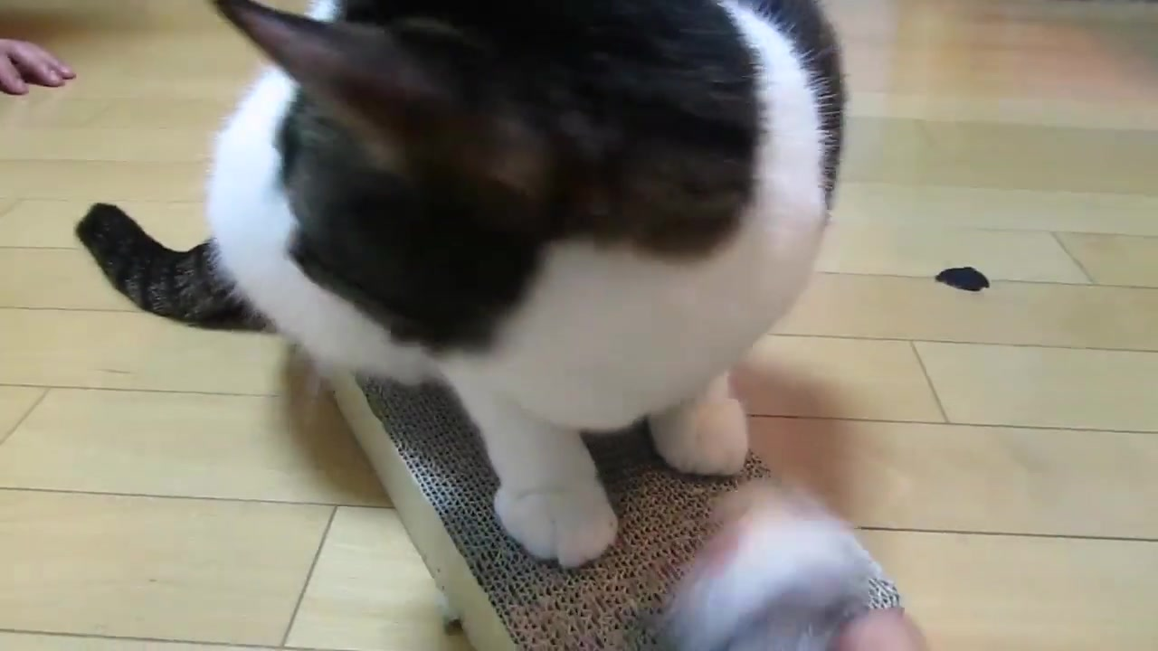

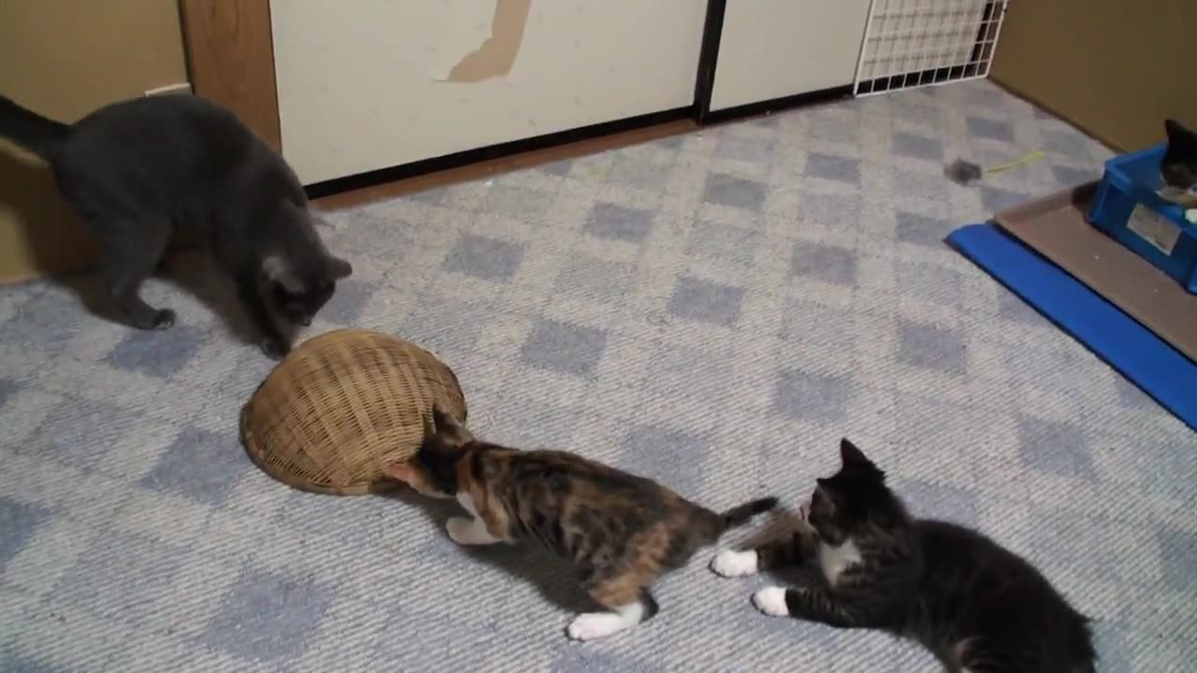


Subjective analysis of the prediction (“high like count video” by the prediction model)
Prediction: Above average Actual: Above average
Prediction: Above average Actual: Above average
Prediction: Below average Actual: Above average
Prediction: Above average Actual: Above average
Prediction: Above average Actual: Above average
Prediction: Below average Actual: Above average
Notes:
While the accuracy of the model is not enough for a real environment, specific types of videos have like counts are detected. This slide shows example of videos correctly detected. The left two videos are multiple dogs and cats are playing and the middle two videos have close-up images of a cat in the videos. All of the videos have relatively bright environment to show anical facial expressions.
Some of high like count videos have these characteristics and the model can capture these features to some extent. However, the model cannot capture these characteristics under some conditions. The top right one has a little dark environment while the layout has similar with others. The top bottom one has a brighter environment and close-up cat images while the cat is stark white. Probably due to lack of patterns of brightness and color of animals, the model cannot predict like count of those accurately. Also, the current augmentation variety may not be enough to create variety of patterns. Increasing patterns of high like count videos in terms of brightness and color of animals in the training data by data augmentation and adding new data is a key consideration.
As mentioned in the previous page, like count is strongly correlated with view count. Therefore, improving the data patterns for high like count videos will contribute to improvement of view count prediction as well.

Slide 8
Software overview & Enhancements
Currently, Python & Flask web framework used to integrate the developed deep learning models & UI.
Simple UI developed in plain HTML with limited validations for user to input Video and report results.
Developed models packed manually to the application to consume.
Application should be enhanced could native.
Enhance build, train, and deploy machine learning model with fully managed infrastructure, tools, and workflows. Like Sage Maker.
Application should enhance to have user authentication , logging , monitoring features to provide better User experience and to increase the usage of application.

Slide 9
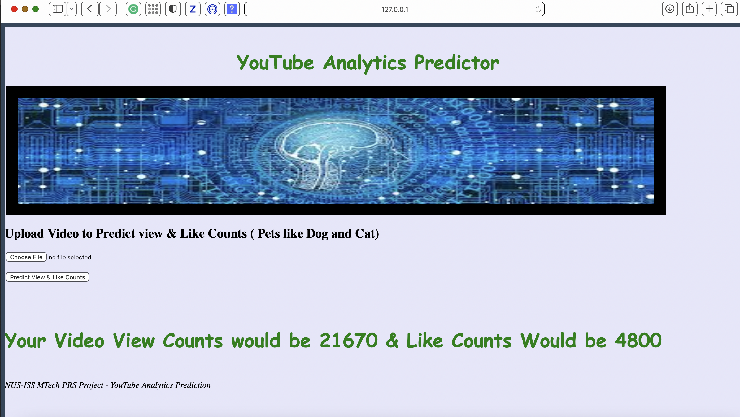
Sample test result
User login to YouTube Analytics Predictor
User has the option to upload the Video.
After uploading the Video Application get below information to pass to First Model to get Like count.
Extraction of Thumbnail file
Retrieve meta data like fps, duration
Slice Video to frames
Model predicts the Like count
Predicted Like count will be passed to deep learning model to predict View count.
User get the Like and View count on the web page.

